Slide 1
Employee Data Analysis using Excel
STUDENT NAME:V.Keerthika
REGISTER NO:312204240
DEPARTMENT:B.com(Accounting and finance )
COLLEGE : AnnaI violet arts and science college

Slide 2

PROJECT TITLE
Visualizing employee attendance trends with excel charts

Slide 3
AGENDA
Problem Statement
Project Overview
End Users
Our Solution and Proposition
Dataset Description
Modelling Approach
Results and Discussion
Conclusion
3/21/2024 Annual Review

Slide 4
PROBLEM STATEMENT
Employee attendance is a critical aspect of workforce management that directly impacts productivity, morale, and overall organizational performance. Understanding attendance patterns can help managers identify issues such as frequent absenteeism, peak absence periods, and individual employee performance.

Slide 5
PROJECT OVERVIEW
The project aims to create a comprehensive visualization of employee attendance data using Excel charts to identify trends, patterns, and areas for improvement in workforce management.

Slide 6
WHO ARE THE END USERS?
HR Managers
Team Leaders/Supervisors
Upper Management/Executive
Data Analysts
Employee Relations Specialists

Slide 7
OUR SOLUTION AND ITS VALUE PROPOSITION
Our solution leverages the power of Excel to create dynamic, visually compelling charts that help organizations track, analyze, and optimize employee attendance. By transforming attendance data into clear, actionable visualizations, our solution provides HR teams, managers, and decision-makers with an intuitive way to monitor trends and address workforce attendance challenges proactively.

Slide 8
Dataset Description
To effectively visualize employee attendance trends, the dataset needs to be structured in a way that captures key attendance-related information for each employee. Below is a breakdown of the fields (columns) and their descriptions
By organizing your attendance data in this structure, you lay the foundation for advanced modeling, analysis, and visualization using Excel charts and dashboards.

Slide 9
THE "WOW" IN OUR SOLUTION
To create "wow" moments when visualizing employee attendance trends in Excel, here are some impactful techniques you can use to make your data pop while delivering clear insights
1. Heat Maps for Daily Attendance
2. Sparkline Attendance Patterns
3. Dynamic Dashboards with Pivot Charts
4. Stacked Bar Charts for Total Attendance
5. Interactive Charts with Drop-Down Menus
3/21/2024 Annual Review
9

Slide 10
MODELLING
Modeling employee attendance trends with Excel charts involves structuring data, calculating key metrics, and using a variety of visualization techniques to turn numbers into insights. The result is a powerful, data-driven approach that empowers organizations to monitor attendance, identify trends, and make informed decisions to improve overall workforce productivity. Excels flexibility allows for a scalable, customizable, and interactive experience that can adapt to any organizations needs.
10

Slide 11
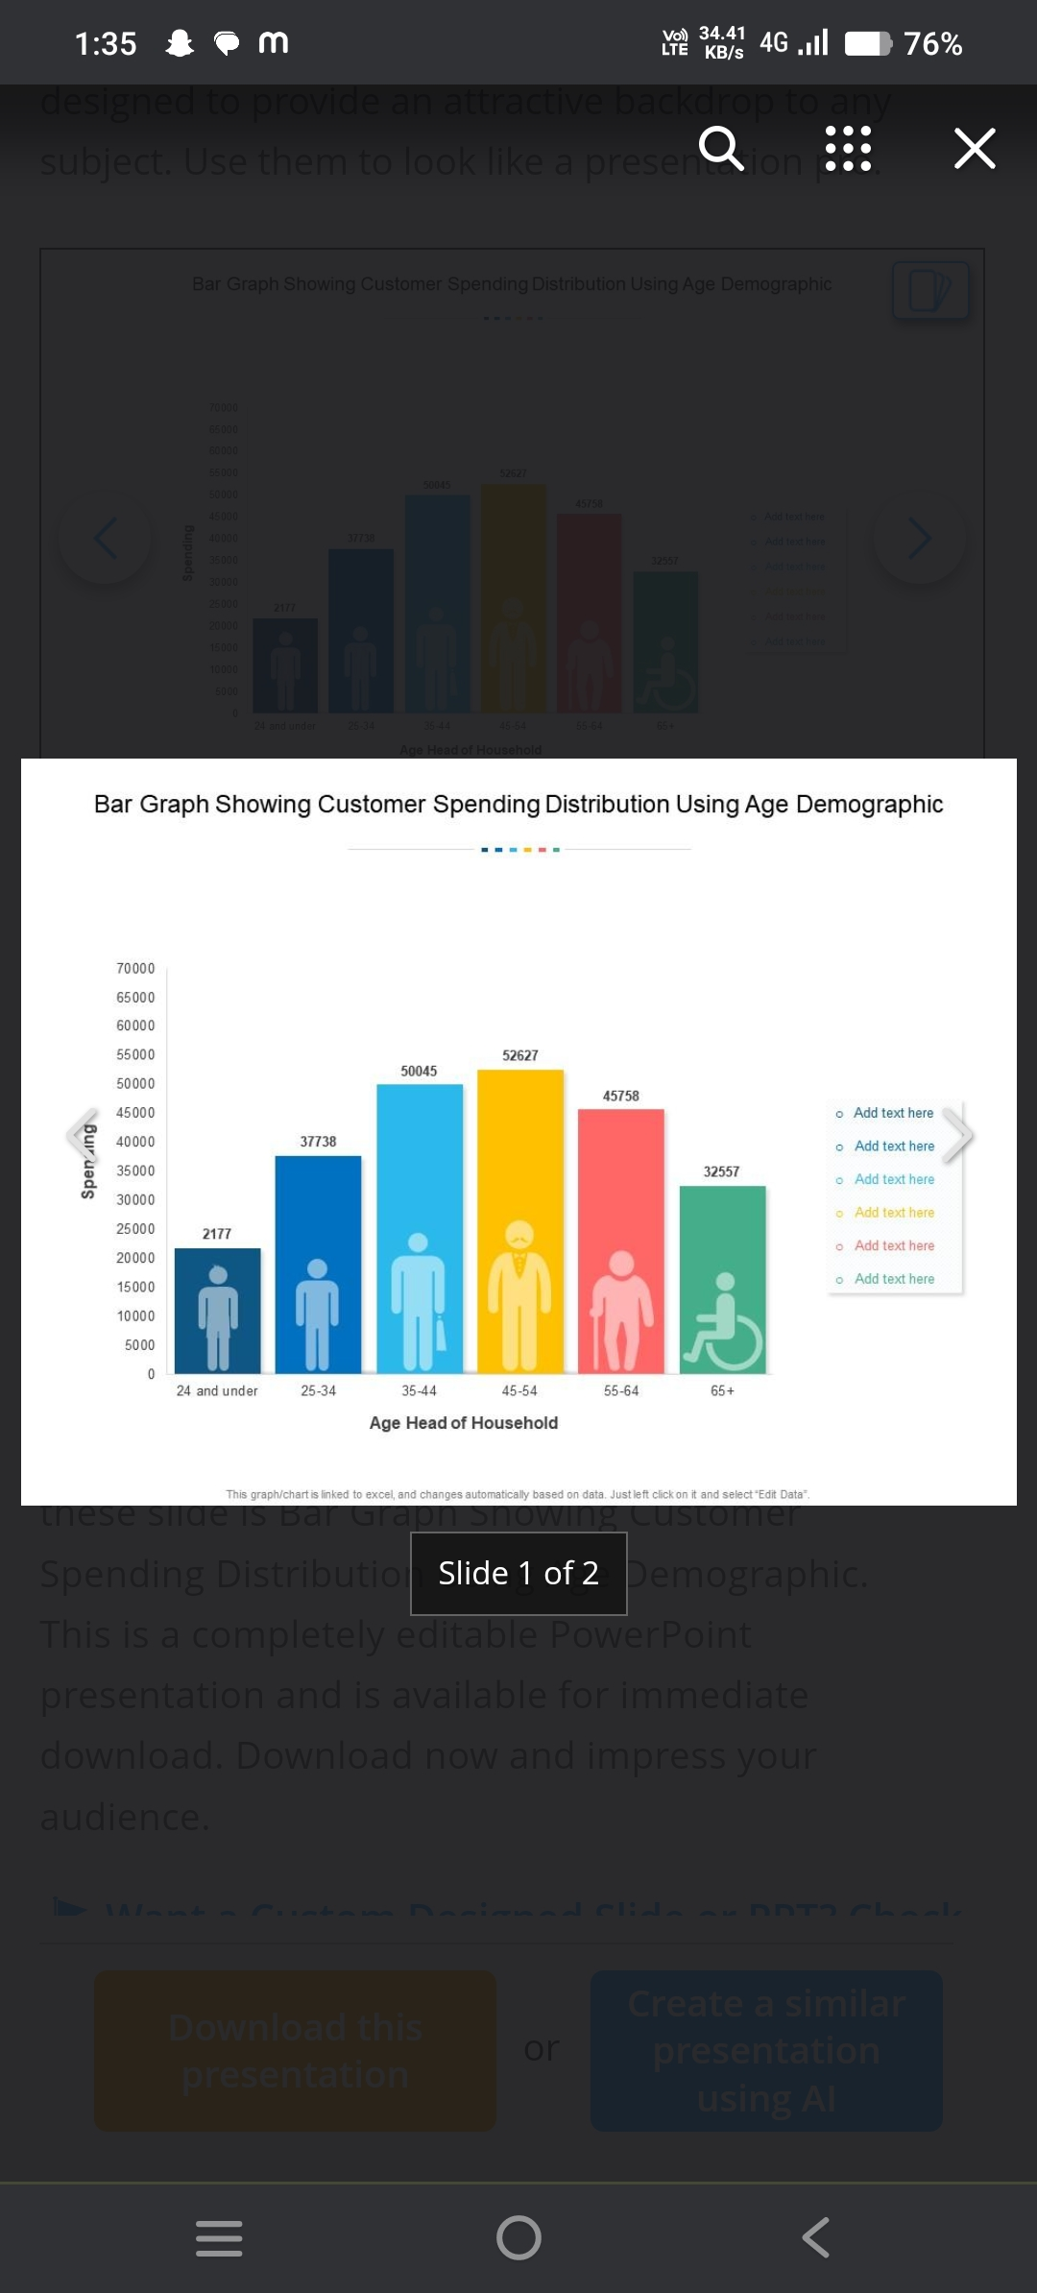
RESULTS
11

Slide 12
conclusion
Visualizing employee attendance trends using Excel charts transforms raw data into actionable insights, enabling organizations to better understand workforce behavior and address attendance-related issues efficiently. By utilizing a variety of chart types—such as heat maps, sparklines, pivot charts, and funnel charts—you can highlight patterns, identify problematic areas, and demonstrate correlations between attendance and performance. These tools offer a dynamic, visually engaging approach to tracking employee attendance, making it easier for managers and HR teams to make data-driven decisions.

